Slide 1

Speedup in Hardwired and Microprogrammed Control
Computer Organization and Architecture | Hardwired and Microprogrammed Control
Computer Organization and Architecture | Hardwired and Microprogrammed Control | Bachelor of Engineering
DISCOVER · LEARN · EMPOWER
Notes:
Welcome everyone to today's lecture on Speedup within the context of Control Units. We will focus specifically on how hardwired and microprogrammed designs impact execution speed. This session is designed to help you evaluate performance differences critically. Let us begin by understanding the core outcomes we aim to achieve.

Slide 2
Course Outcomes
SLIDE 2 / 10
Course Outcome
CO | BT LEVEL | DESCRIPTION
CO1 | BT3 | Apply number systems and digital logic to design basic digital circuits
CO2 | BT4 | Analyze register organization and instruction set architecture
CO3 | BT3 | Implement computer arithmetic algorithms and floating-point operations
CO4 | BT5 | Analyze memory hierarchy and input-output organization
CO5 | BT6 | Evaluate control unit design and pipelining performance
Chandigarh University
2 / 10
Notes:
Today's lecture directly addresses Course Outcome 5, which requires you to evaluate control unit designs. You will learn to compare hardwired and microprogrammed approaches based on their speed characteristics. This evaluation is crucial for understanding pipelining performance in modern processors. Please note this specific outcome as the primary goal of our discussion.

Slide 3
Learning Objectives
SLIDE 3 / 10
Learning Outcomes
1
Analyze the fundamental speed differences between hardwired and microprogrammed control units.
2
Calculate speedup factors when replacing microcode with hardwired logic for specific instructions.
3
Evaluate the trade-offs between execution speed and design flexibility in control units.
4
Synthesize performance metrics to determine the optimal control unit for a given architecture.
5
Critique the impact of control unit speed on overall system throughput and latency.
Chandigarh University
3 / 10
Notes:
By the end of this session, you will be able to analyze why hardwired control is generally faster than microprogrammed control. We will calculate specific speedup factors using real-world instruction examples. You will also evaluate the trade-offs between raw speed and the flexibility offered by microcode. Finally, you will synthesize these metrics to make informed design decisions.

Slide 4
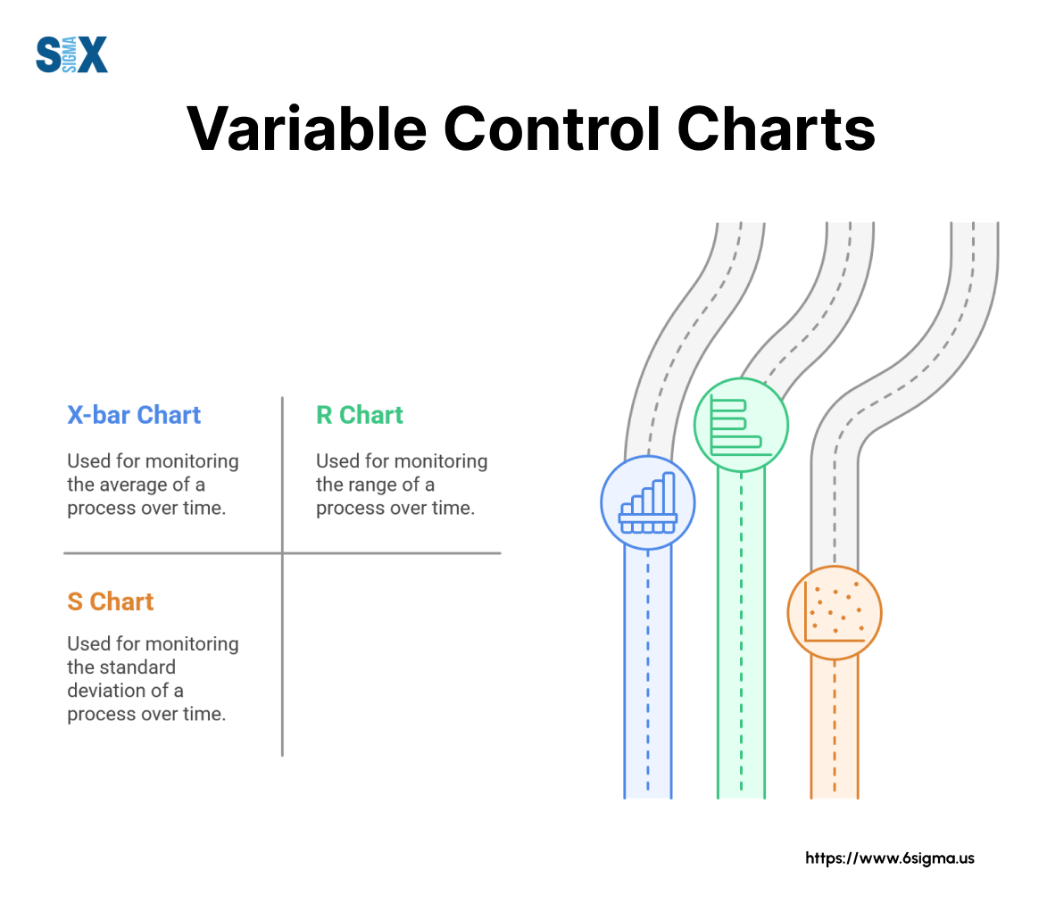
Lecture
SLIDE 4 / 10
Definition of Speedup
1
Speedup measures the performance improvement of a system compared to a baseline design.
2
In control units, speedup is defined as the ratio of execution time of microprogrammed to hardwired control.
3
A speedup greater than one indicates the new design executes instructions faster than the baseline.
4
Speedup is calculated by dividing the time taken by the slower method by the faster method.
5
This metric is critical for evaluating the efficiency of the control unit in a processor.
The Complete Guide to Variable Control Charts in Six σ - SixSigma.us
Chandigarh University
4 / 10
Notes:
Speedup is essentially a ratio that tells us how much faster one design is compared to another. In our context, we compare the execution time of a microprogrammed control unit against a hardwired one. If the hardwired version takes less time, the speedup value will be greater than one. This concept is fundamental to understanding performance optimization in computer architecture.

Slide 5
Lecture
SLIDE 5 / 10
Hardwired vs Microprogrammed Speed
1
Hardwired control uses dedicated logic gates to generate control signals directly from the instruction decoder.
2
Microprogrammed control uses a sequence of microinstructions stored in control memory to generate signals.
3
Hardwired control typically offers higher speed because it eliminates memory access delays for control signals.
4
Microprogrammed control introduces a delay due to fetching each microinstruction from control memory sequentially.
5
The speed advantage of hardwired control is most significant in high-frequency, high-performance processors.
Chandigarh University
5 / 10
Notes:
The primary reason for speed differences lies in how control signals are generated. Hardwired control uses direct logic gates, which operate at the speed of the hardware itself. In contrast, microprogrammed control must fetch microinstructions from memory, introducing a fetch delay for every step. This memory access overhead makes microprogrammed control inherently slower than its hardwired counterpart.

Slide 6
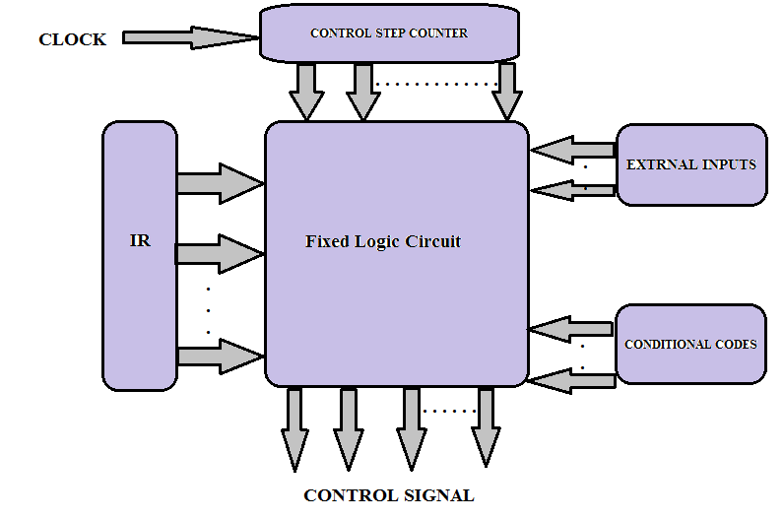
Lecture
SLIDE 6 / 10
Speedup Calculation Formula
1
Speedup = (Execution Time of Microprogrammed Control) / (Execution Time of Hardwired Control).
2
Execution time depends on the number of clock cycles required for each control method.
3
If microprogrammed control takes 4 cycles and hardwired takes 2 cycles, the speedup is 2.
4
The formula assumes the clock cycle time remains constant for both designs for fair comparison.
5
Higher speedup values indicate a more efficient transition from microprogrammed to hardwired logic.
Hardwired and Micro-programmed Control Unit (source: vcmos.com)
Chandigarh University
6 / 10
Notes:
Let's look at the formula for calculating speedup. It is simply the execution time of the slower method divided by the faster method. For example, if a microprogrammed unit takes 4 clock cycles to execute an instruction and the hardwired unit takes 2 cycles, the speedup is 2. This means the hardwired version is twice as fast for that specific instruction.

Slide 7
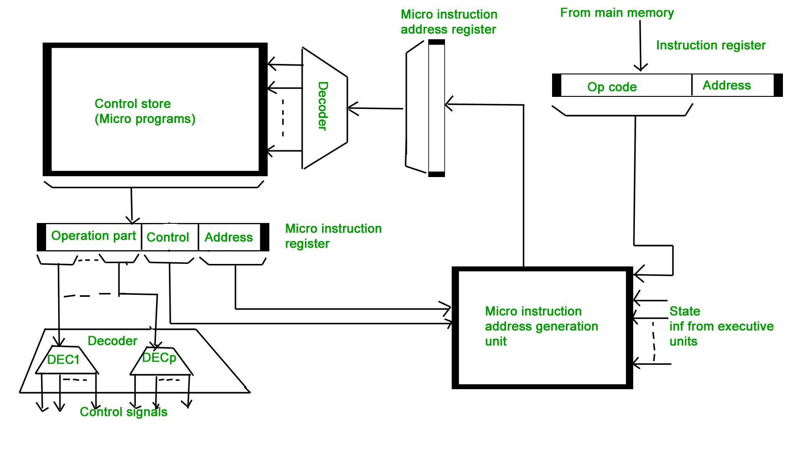
Lecture
SLIDE 7 / 10
Worked Numerical Example
SPEEDUP CALCULATION
30 ns divided by 10 ns equals a speedup factor of 3.
• Consider an instruction requiring 3 microinstructions in microprogrammed control with 10ns per microinstruction.
• Total time for microprogrammed control is 30 nanoseconds for this specific instruction execution.
• The equivalent hardwired logic executes the same instruction in a single 10ns clock cycle.
• This example demonstrates a threefold performance improvement using hardwired logic for this instruction.
Hardwired and Micro-programmed Control Unit - GeeksforGeeks (source: www.geeksforgeeks.org)
Chandigarh University
7 / 10
Notes:
Let's work through a concrete example to make this clear. Suppose an instruction requires 3 microinstructions, each taking 10 nanoseconds, totaling 30 nanoseconds. The hardwired version executes this in just one cycle of 10 nanoseconds. Dividing 30 by 10 gives us a speedup of 3. This means the hardwired approach is three × faster for this specific operation.

Slide 8
Lecture
SLIDE 8 / 10
Factors Affecting Speedup
1
The complexity of the instruction set determines the potential speedup achievable through hardwiring.
2
Frequent use of complex instructions yields higher speedup when converted to hardwired logic.
3
Control memory access time is a major bottleneck limiting the speed of microprogrammed units.
4
Pipeline depth and clock frequency also influence the overall speedup observed in the system.
5
Design constraints like chip area and power consumption may limit the extent of hardwiring.
Hardwired and Micro-programmed Control Unit (source: vcmos.com)
Chandigarh University
8 / 10
Notes:
Several factors influence how much speedup we can actually achieve. The complexity of the instruction set plays a huge role; complex instructions benefit more from hardwiring. The speed of the control memory is a critical bottleneck for microprogrammed designs. Additionally, practical constraints like chip area and power consumption often limit how much logic we can hardwire.

Slide 9

Lecture
SLIDE 9 / 10
Key Takeaways
1
Hardwired control is significantly faster than microprogrammed control due to the absence of memory fetch delays.
2
Speedup is calculated as the ratio of execution × between the two control unit designs.
3
Complex instructions with many steps show the highest speedup when implemented with hardwired logic.
4
Designers must balance the speed benefits of hardwiring against the flexibility and cost of microprogramming.
5
Evaluating control unit speed is essential for optimizing overall processor performance and throughput.
Source: www.slideteam.net
Chandigarh University
9 / 10
Notes:
To summarize, hardwired control is faster because it avoids memory fetch delays inherent in microprogramming. We calculate speedup by comparing execution ×, where higher values indicate better performance. Complex instructions benefit the most from hardwiring, but designers must balance this with flexibility and cost. Understanding these trade-offs is key to optimizing processor performance.

Slide 10
Lecture
SLIDE 10 / 10
References
COMPUTER ORGANIZATION AND DESIGN
The Hardware/Software Interface — David A. Patterson, John L. Hennessy
COMPUTER ARCHITECTURE
A Quantitative Approach — John L. Hennessy, David A. Patterson
• Computer Organization and Architecture — William Stallings
• Computer System Architecture — M. Morris Mano & Rajib Mall
• Computer Organization — Carl Hamacher, Zvonko Vranesic, Safwat Zaky
Chandigarh University
10 / 10
Notes:
These five textbooks provide the foundational knowledge for understanding control unit design and performance evaluation. I encourage you to consult Stallings and Mano for detailed explanations of hardwired and microprogrammed structures. Patterson and Hennessy offer excellent quantitative approaches to analyzing speedup and performance. Hamacher's text also provides deep insights into the hardware-software interface. Please refer to these resources for further study.

